Slide 1
Data Science Capstone
03/09 Team Update
Sam Speake

Slide 2
New Work Pipeline
Domain team
Creates, organizes, and maintains a repository of relevant information
Prioritizes strategies for bias mitigation and passes them to the statistics team
Statistics Team
Validates methods passed from domain team
“Translates” methods into equations/algorithms/etc for the development team to integrate

Slide 3
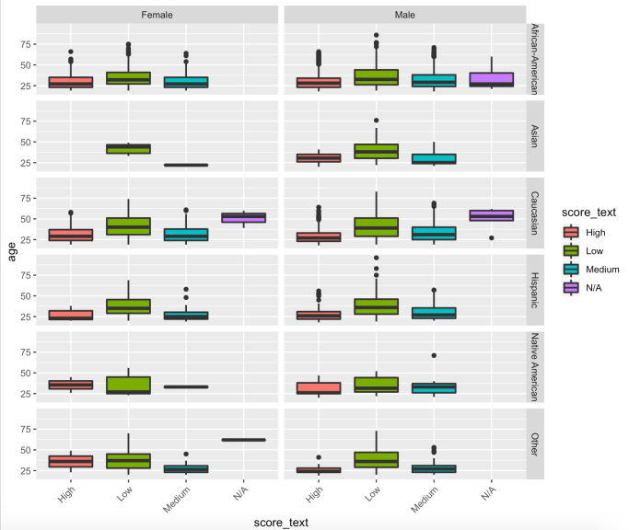
New Work Pipeline cont.
Development Team
Integrates methods from statistics team
Compares outcomes to baseline ordinal logistic regression
Provides feedback to domain and statistics teams

